Slide 1

Classification and Regression Trees
Dr Kanishka Bhattacharya

Slide 2
Trees and Rules
Goal: Classify or predict an outcome based on a set of predictors
The output is a set of rules
Example:
Goal: Classify a loan as paid back or charged off.
Rule might be “IF (Term =60 months) AND (amount>11000) THEN Class = 1 (charged off)”
Also called CART, Decision Trees, or just Trees
Rules are represented by tree diagrams

Slide 3
Learning Objectives
How to interpret and use the output of tree algorithms
Understanding the results
Classifying new observations
How does the algorithm determine best rules?
How to build trees (split)
When to stop
Comparing different data mining methods

Slide 4
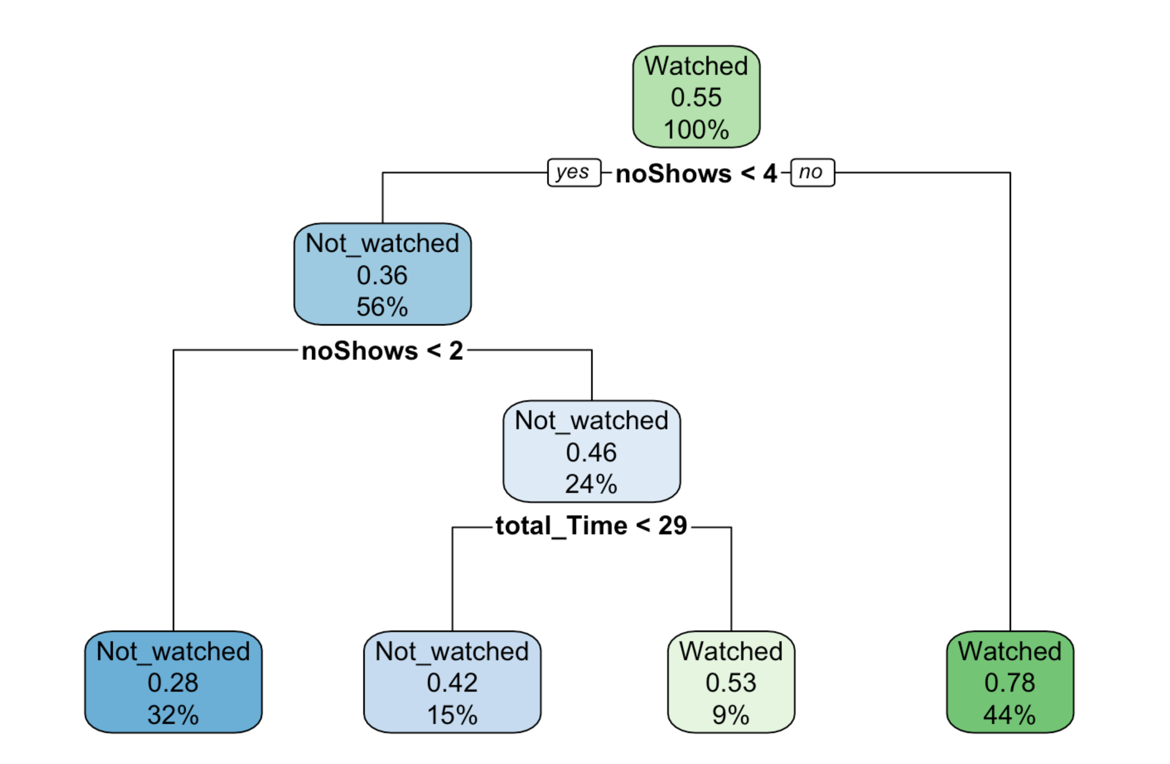
Back to BBC iPlayer Data
Majority vote
Percentage of watched observations
Percentage of data in this node
Majority vote
Percentage of watched observations
Percentage of data in this leaf

Slide 5
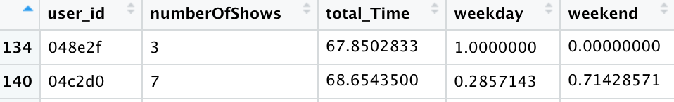
Back to BBC iPlayer Data

Slide 6
Classification trees: Output
Root Nodes
Number of Levels
(Depth)
Interior Nodes
Leaf Nodes

Slide 7
Classification and regression trees
Procedure: Build a tree by splitting on variables
Trees do not assume a certain model for example: it does not require a linear model.Therefore, they are a nonparametric method.
Interpretable: Output is a set of rules that can be compared and combined with intuition.
They are called trees because they are displayed as trees
When to stop splitting
How to avoid overfitting
Notes:
This is a restricted tree where I only chose two variables. I will show you more comphrensive one next

Slide 8
How does the algorithm determine best rules? How should we choose the best split?
Regression
Classification

Slide 9
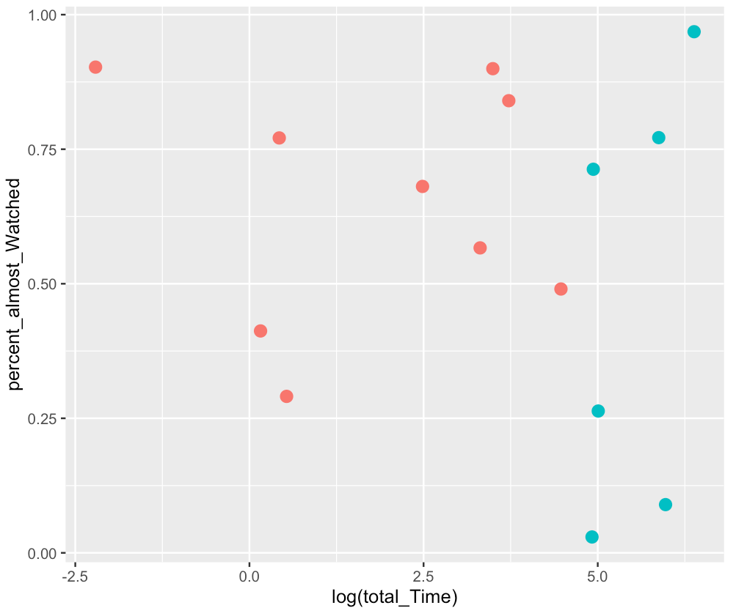
How splitting is done in CART
We would like to split two classes as much as possible
Trees only use horizontal or vertical lines to make splits
In the below graph, what is the best split?
Notes:
Let me show you how it works. I am looking at the Lending club example. I will only consider two independent variables for the sake of simplicity, DTI and income.
SO the algorithm looks to split the observations recursively to improve the purity. I will define this precisely in a second. Then stops when a criteria is satisfied.
It will only use straight line no curves and etc.

Slide 10
How splitting is done in CART
Notes:
Let me show you how it works. I am looking at the Lending club example. I will only consider two independent variables for the sake of simplicity, DTI and income.
SO the algorithm looks to split the observations recursively to improve the purity. I will define this precisely in a second. Then stops when a criteria is satisfied.
It will only use straight line no curves and etc.

Slide 11
How splitting is done in CART
But usually such “perfect” splits are not possible
Then the idea is to find splits that will increase “purity”
And continue in this manner in each newly created box hat contains a subset of the data
Let’s see a more realistic data set
Notes:
Let me show you how it works. I am looking at the Lending club example. I will only consider two independent variables for the sake of simplicity, DTI and income.
SO the algorithm looks to split the observations recursively to improve the purity. I will define this precisely in a second. Then stops when a criteria is satisfied.
It will only use straight line no curves and etc.

Slide 12
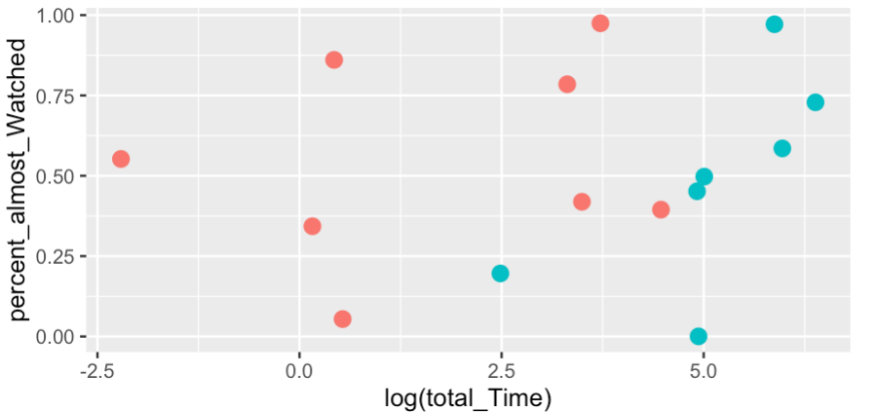
How splitting is done in CART
Notes:
Let me show you how it works. I am looking at the Lending club example. I will only consider two independent variables for the sake of simplicity, DTI and income.
SO the algorithm looks to split the observations recursively to improve the purity. I will define this precisely in a second. Then stops when a criteria is satisfied.
It will only use straight line no curves and etc.

Slide 13

Purity measures
Consider an example with two classes, for example, default or paid off.
When $p_{2}=p_{1}=0.5$, purity is at the lowest level(Gini index and entropy are at their highest values)
What if $p_{1}=0 or 1$?
Notes:
Why are they symmetric around 0.5?

Slide 14

Purity measure: Gini Index
How do we measure impurity?
Gini Index for rectangle A containing m records
$Gin\text{i} \text{index} \text{I}\text{(}\text{A}\text{) = 1 −}\sum_{k=1}^{m}{p_{k}^{2}}$
$p_{k}$= proportion of cases in rectangle A that belong to class k
I(A) = 0 when all cases belong to same class
Max value when all classes are equally represented (= 0.50 in binary case)
There are also other metrics, such as Cross entropy
$$entropy \left(A\right)= − \sum_{k=1}^{m}{p_{k}}\log_{2}(p_{k})$$
Entropy is always between 0 and 1
Quite similar to Gini Index
Measure the purity of each part by a potential split and find the total purity by calculating the weighted average purity.
Notes:
Write on board. Let’s say we have two variables only. Then Gini for p_k=1/2 how about 1

Slide 15
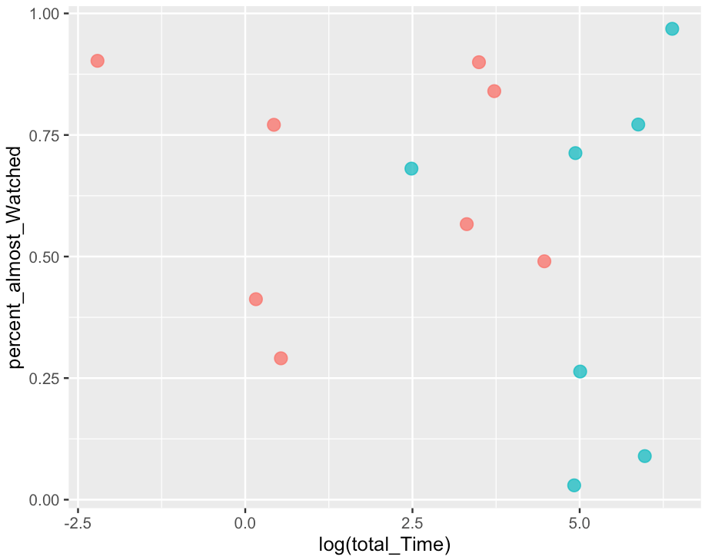
How splitting is done in CART
Notes:
7

Slide 16
How splitting is done in CART
Find the gini index of a split at percent almost watched =0.25, for the data points on the right
Draw the resulting tree

Slide 17
How splitting is done in CART

Slide 18
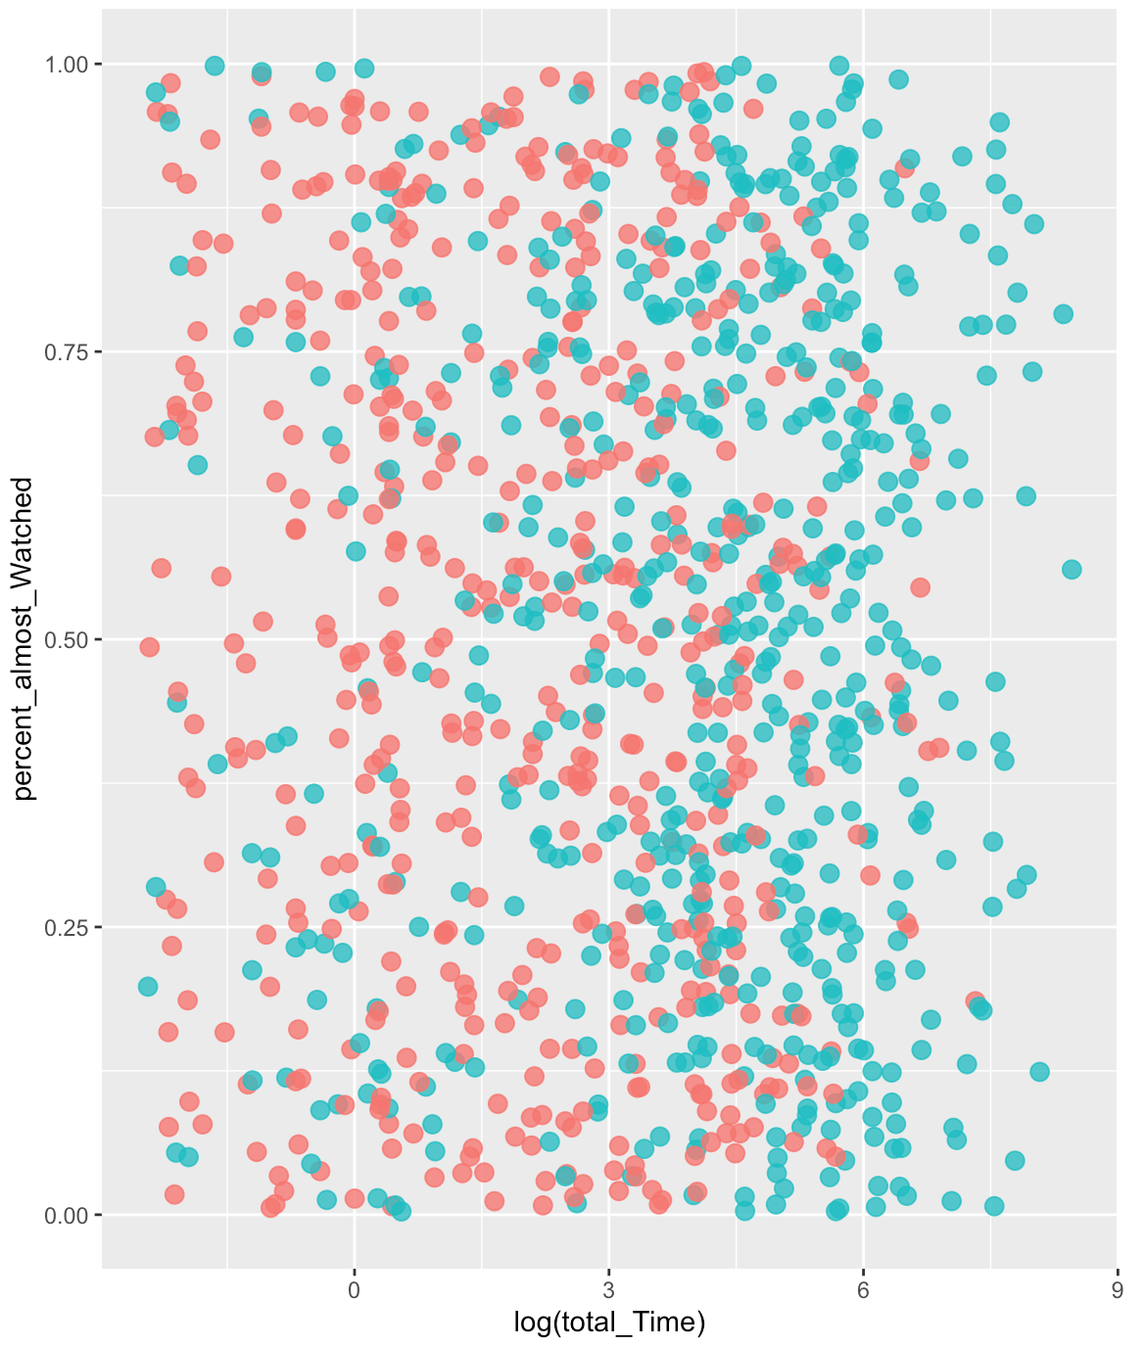
Demonstration
0.2
0.5

Slide 19
Demonstration
0.2
0.5

Slide 20
Recursive Partitioning Steps
Recap
Pick one of the predictor variables, x_{i}
Pick a value of x_{i,} say s_{i}, that divides the training data into two (not necessarily equal) portions
Measure how “pure” or homogeneous each of the resulting portions are
“Pure” = containing records of mostly one class
Algorithm tries different values of x_{i,} say s_{i} to maximize purity in initial split
After you get a “maximum purity” split, repeat the process for a second split, and so on
Notes:
But how do we measure purity? Any ideas?

Slide 21
Back to BBC iPlayer Data

Slide 22
From scores to classification
Each leaf node label is determined by “voting” of the records within it, and by the cutoff value
Records within each leaf node are from the training data
Default cutoff=0.5 means that the leaf node’s label is the majority class.
Cutoff = 0.75: requires majority of 75% or more “1” records in the leaf to label it a “1” node

Slide 23

Prediction Trees
Assume that the response variable is continuous, hence we are trying to predict (not to classify, what is the difference again?)
Impurity measured by sum of squared deviations from leaf mean
Performance measured by RMSE (root mean squared error)
Find the split that minimizes the total error from the mean of each “box”.
Let ${\hat{y}}_{j}$ denote the average of all the responses in the j the box
Find the error by estimating the response of all the observations in the j the box by the average of all these observations (${\hat{y}}_{j}$)
$$Y_{J}=∑{{(y_{ij}−\hat{y}}_{j})}^{2}$$
Then find the total sum over all the boxes
$∑Y_{j}$
Among all the splits pick the one that minimizes this sum

Slide 24
Example: Prediction trees
Consider an example with four records
Dependent variable is the interest rate and the independent variable is income
What if we split at time viewed=50
We can evaluate the change in squared error
In the example initially total squared error is 19
After the split it is 8+2=10
Time Viewed | Number of Shows M2
10 | 10.0
45 | 14.0
Average | 12.0
Sq Error | 8
Time Viewed | Number of Shows M2
10 | 10.0
45 | 14.0
55 | 8.0
60 | 10.0
Average | 10.5
Sq Error | 19
Time Viewed | Number of Shows M2
55 | 8.0
60 | 10.0
Average | 9.0
Sq Error | 2

Slide 25
When should we stop splitting?

Slide 26
Back to BBC iPlayer Data

Slide 27
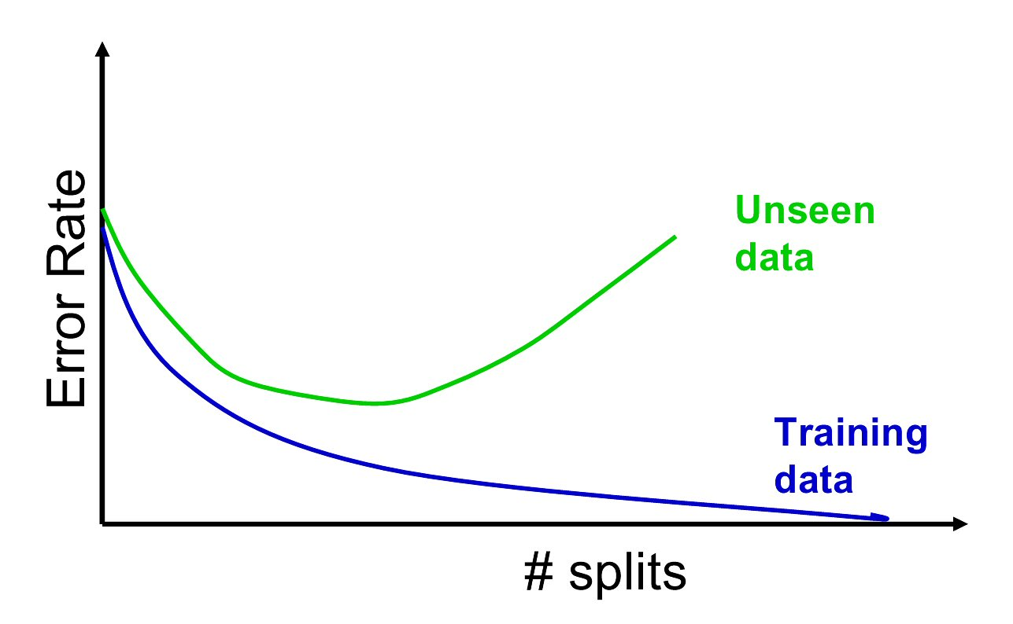
The Overfitting Problem
Natural end of process is 100% purity in each leaf
This overfits the data, which end up fitting noise in the data
Overfitting leads to low predictive accuracy of new data
Past a certain point, the error rate for the validation data starts to increase
Stopping Tree Growth
Size of the tree
Determine when to stop splitting
Pre-pruning
Post-Pruning

Slide 28
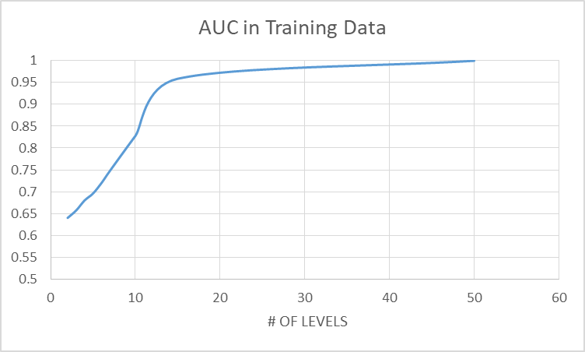
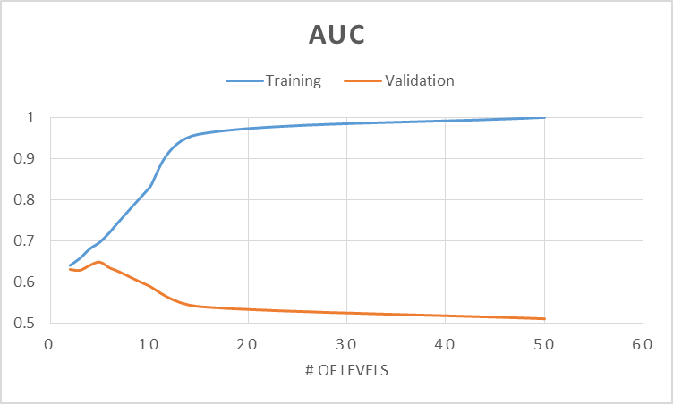
Back to BBC data
I use the validation data set
Let’s look at AUC as a function of the number of splits for training and validation data
How many splits should we use?

Slide 29
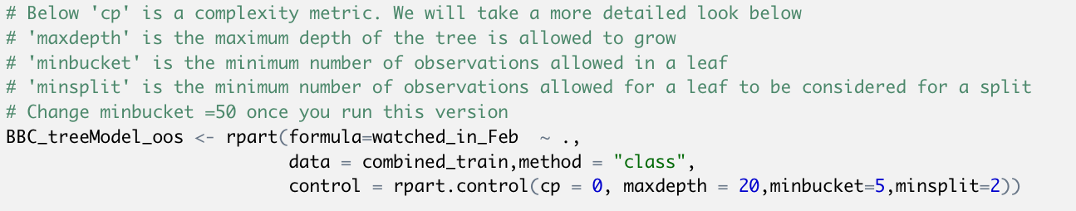
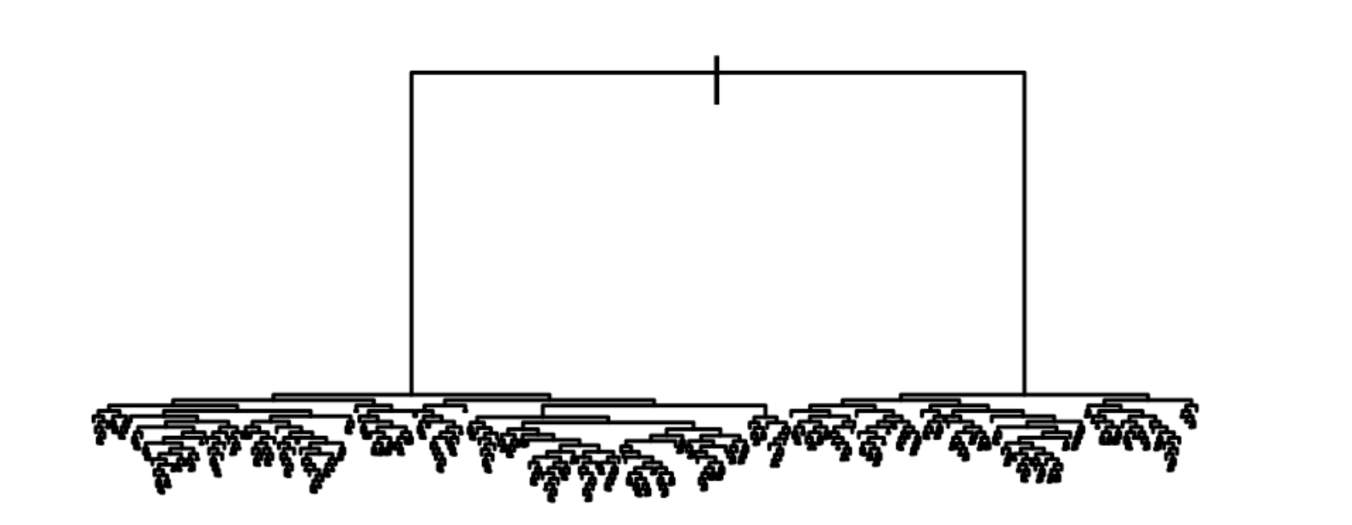
R code

Slide 30
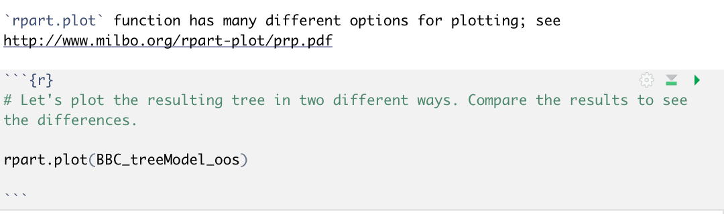
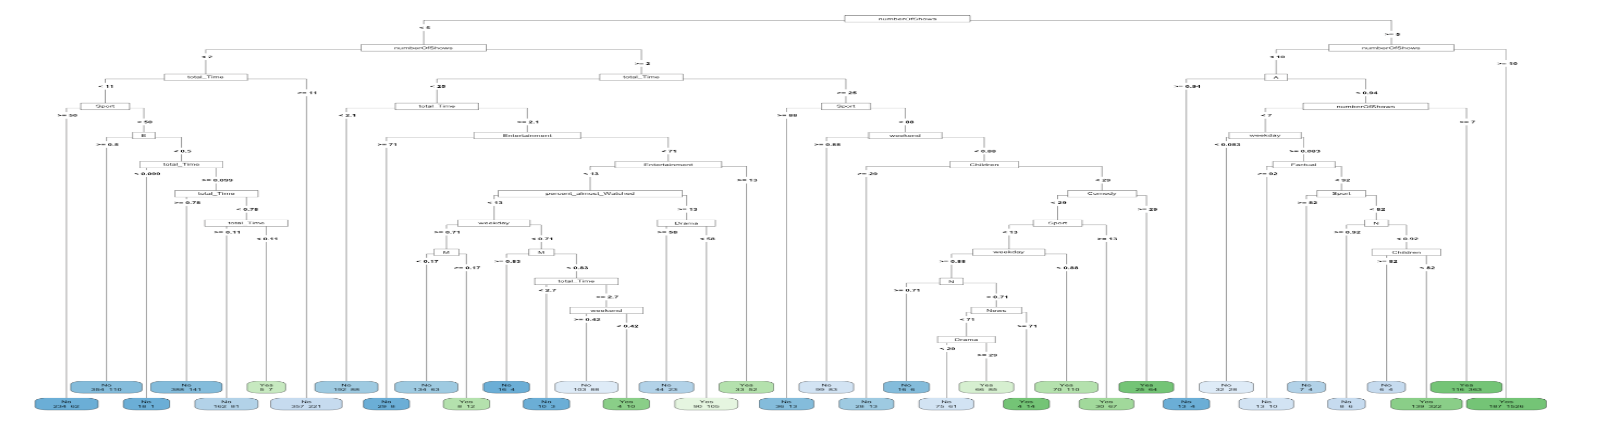
Trees on BBC Data
Visualizing trees in R
Notes:
run

Slide 31
Trees on BBC Data
Ok we are now ready to predict whether someone will watch in month 2
Notes:
run

Slide 32
Trees on BBC Data
Ok we are now ready to predict whether someone will watch in month 2
Notes:
run

Slide 33
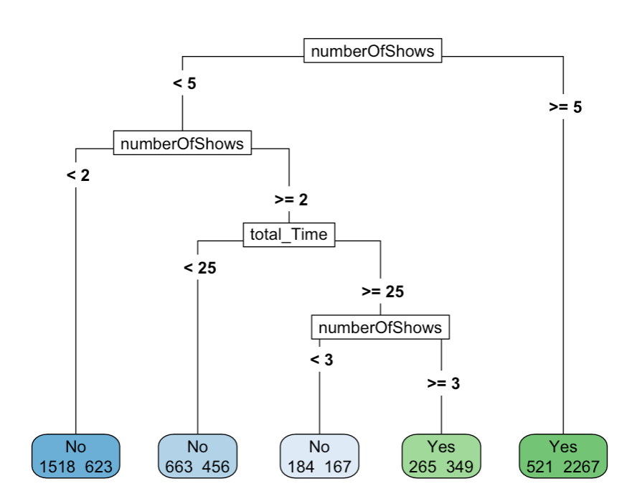
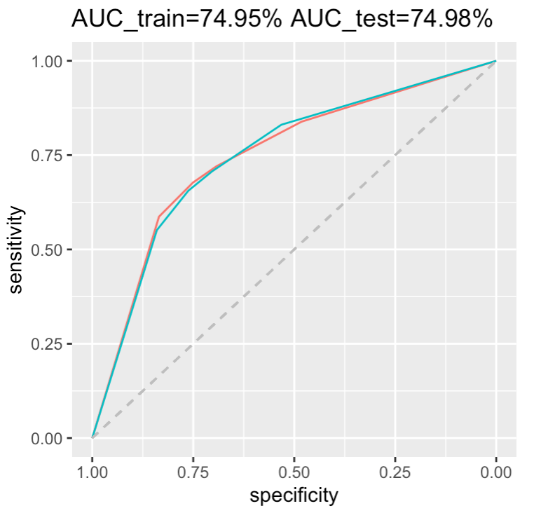

Trees on BBC Data
Ok we are now ready to predict whether someone will watch in month 2
Notes:
run

Slide 34
Pruning
We can prevent this in two ways
Pre-pruning: Set rules to stop tree growth, e.g. the minimum number of observations is more than 100, or number of levels is less than 5.
Post-pruning: : Build a full tree and prune it in a sensible way
CART
Lets tree grow to full extent, then prunes it back
Idea is to find that point at which the validation error begins to rise.
Generate successively smaller trees by pruning leaves.
At each pruning stage, multiple trees are possible.
Use cost complexity to choose the best tree at that stage.

Slide 35

Post-Pruning Algorithm
Fit a large tree (can stop, for example, when each terminal node has fewer than some minimum number of observations).
Fix complexity measure $α$ (denoted by “cp” in R)
Find the tree that minimizes
Error + $α|T|$
where
$\left|T\right|$ indicates the number of terminal nodes of the tree
Error is a measure of predictive accuracy
Report the out-of-sample prediction performance for a set of different $α$’s
I suggest you use caret::train() function –see the Rmarkdown file

Slide 36
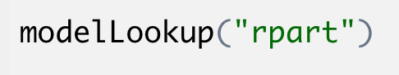
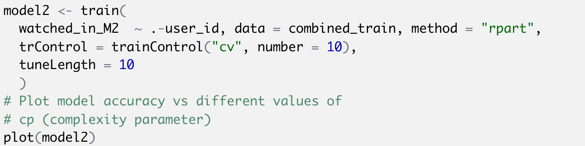
Hypertuning trees using Caret

Slide 37
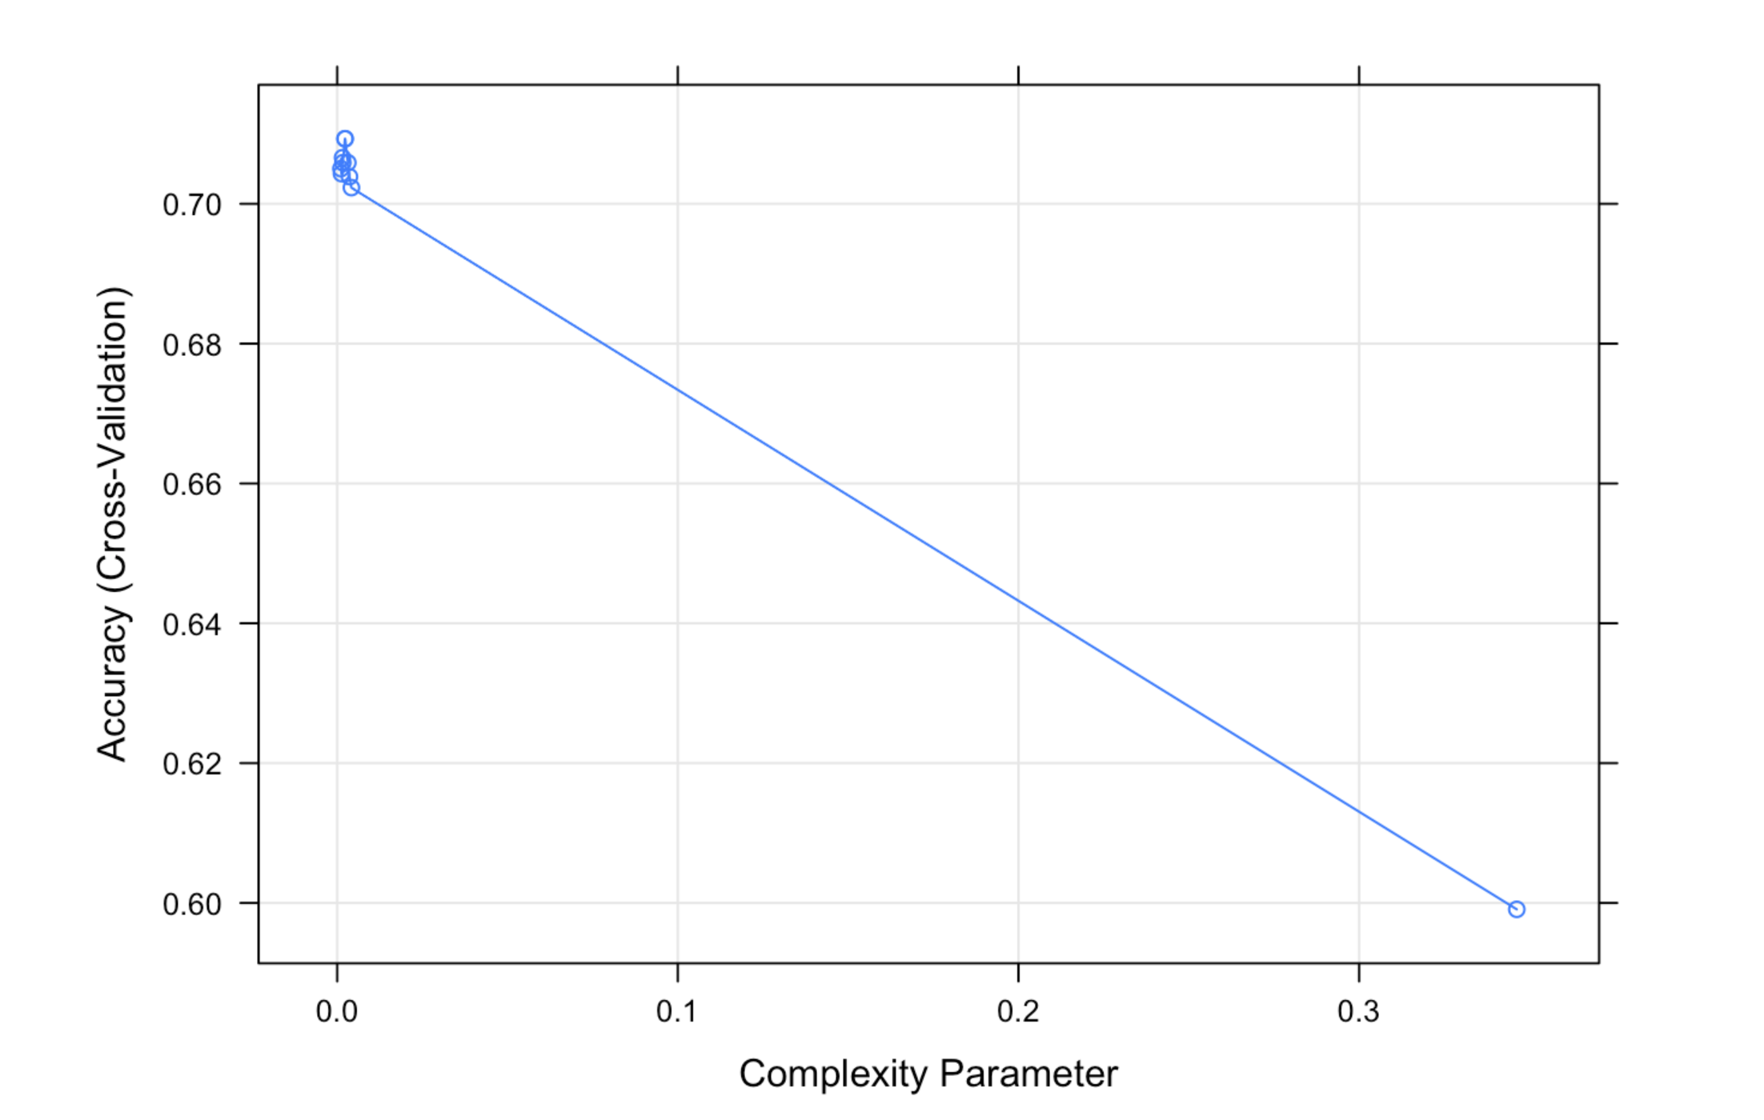
Result

Slide 38
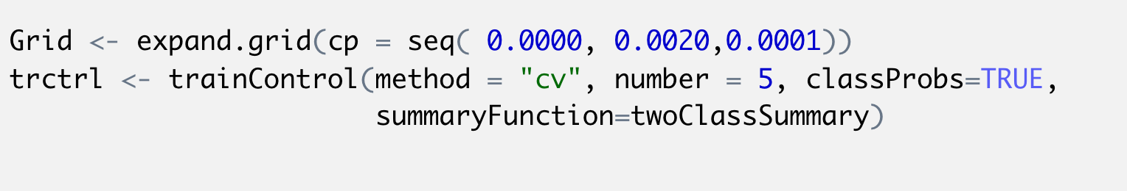
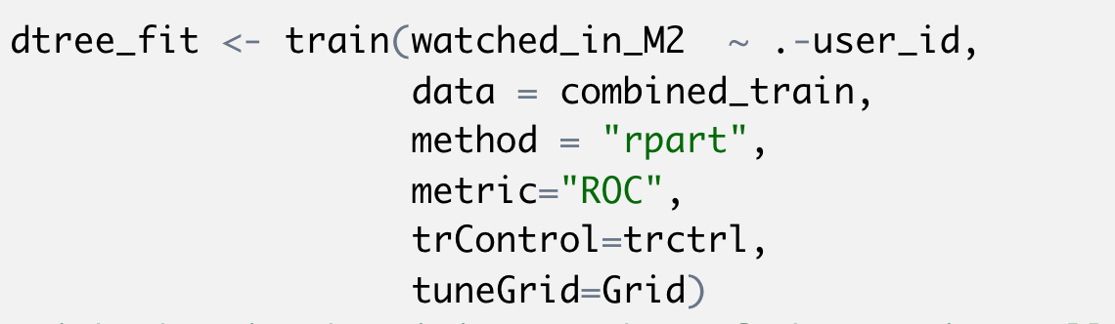
Hyper-tuning trees using Caret

Slide 39
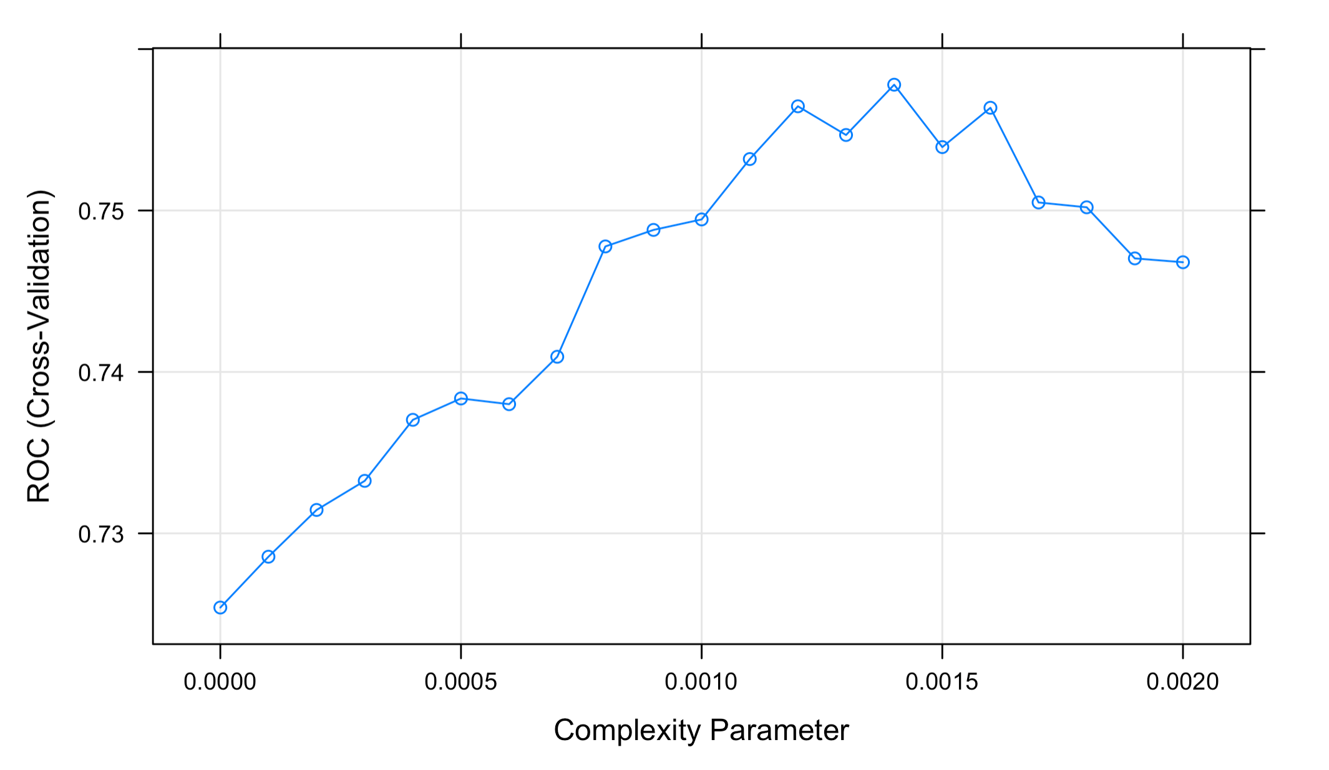
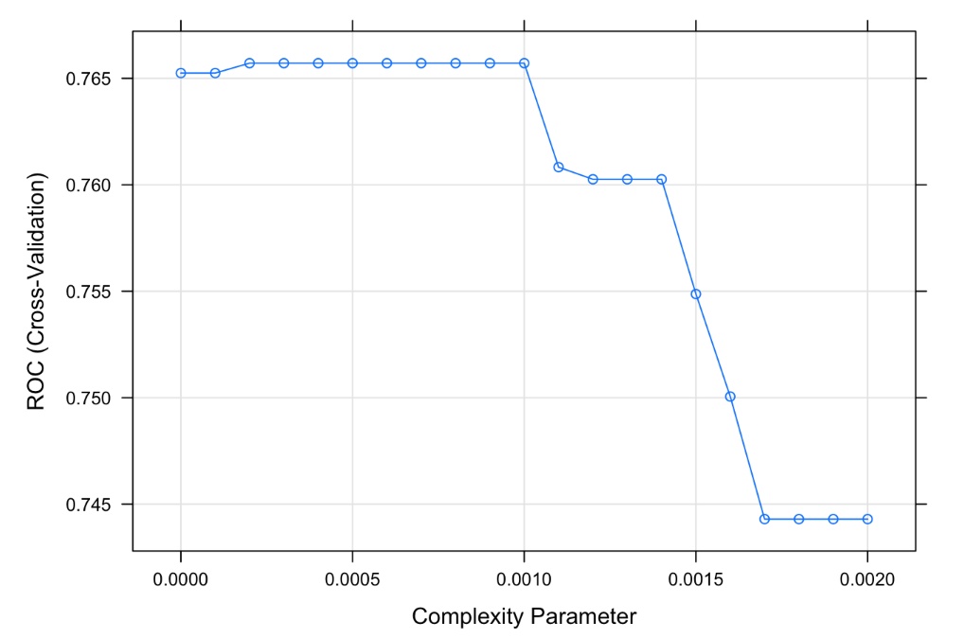
Results

Slide 40
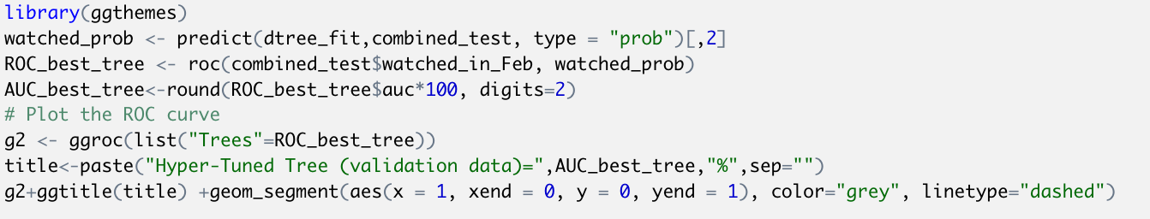
How do we check out of sample performance?

Slide 41
Advantages
Simple to understand, interpret, visualize
No transformation is needed; easy data preparation
Can handle missing data elegantly
Robust to outliers
Can handle non-linear relationships
Fast: Can deal with large data sets

Slide 42
Disadvantages
Large trees can be hard to interpret
Trees have high variance, which causes model performance to be poor
Trees overfit easily

Slide 43
Cookbook: How to use trees!
Once you prepare the data for prediction/classification
Fit a simple tree which results in less than 10 leaves, for example, by controlling the number of points in each leaf; “minbucket”
Use this tree to sense check
Use this tree to get an idea about the predictive accuracy of trees
Hyper tune the parameters using cross validation
You can do this using complexity parameter “cp”
Or other parameters such as “minbucket”
There are many different possible combinations

Slide 44
Comparing data mining algorithms
Speed:
Regression > Trees > k-NN
Robustness: This is the ability of the classifier or predictor to make correct predictions given noisy data or data with missing values.
k-NN>Trees>Regression
Scalability: This refers to the ability to construct the classifier or predictor efficiently given large amounts of data.
Trees ~ Regression > k-NN
Interpretability: This refers to the level of understanding and insight that is provided by the classifier or predictor. Interpretability is subjective and therefore more difficult to assess.
Trees > Regression > k-NN

Slide 45
Learning Objectives
How to interpret and use the output of tree algorithms
Understanding the results
Classifying new observations
How does the algorithm determine best rules?
How to build trees (split)
When to stop
Comparing different data mining methods

Slide 46
Next time: Ensemble methods
Unfortunately, it is tough to avoid overfitting with CART:
Deep tree structure is so unstable that optimal depth is not easily chosen via cross validation, and there’s no theory to fall back on.
Hence trees have high variance.
In order to decrease “variation” we can use multiple trees to classify. There are three common ensemble methods
Bagging
Random forests
Boosting

